Slide 1
Chapter 2
Instruction Set Architecture

Slide 2
Chapter Outline
Machine instructions and program execution
Addressing methods for data operands
Assembly-language representation for instructions, data, and programs
Stacks and subroutines

Slide 3
Memory Organization
Memory consists of many millions of cells
Each cell holds a bit of information, 0 or 1
Information is usually handled in larger units
A word is a group of n bits
Word length can be 16 to 64 bits
Memory is a collection of consecutive words
of the size specified by the word length

Slide 4
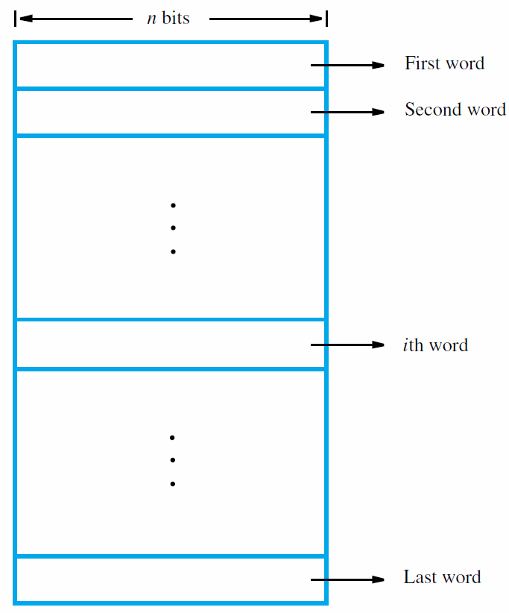

Slide 5
Word and Byte Encoding
A common word length is 32 bits
Such a word can store a 32-bit signed integer
or four 8-bit bytes (e.g., ASCII characters)
For 32-bit integer encoding, bit b₃₁ is sign bit
Words in memory may store data
or machine instructions for a program
Each machine instruction may require
one or more consecutive words for encoding

Slide 6
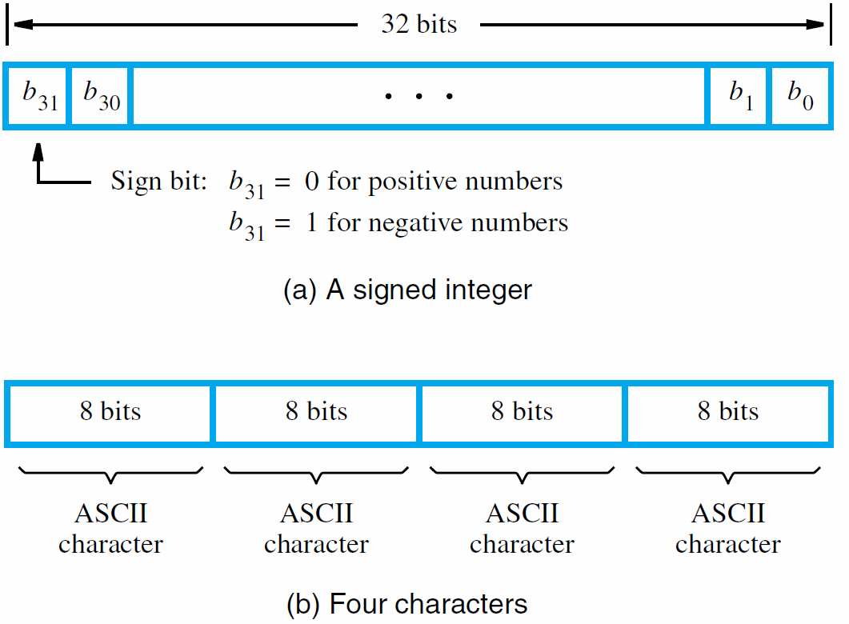

Slide 7
Addresses for Memory Locations
To store or retrieve items of information,
each memory location has a distinct address
Numbers 0 to 2^{k} − 1 are used as addresses
for successive locations in the memory
The 2^{k} locations constitute the address space
Memory size set by k (number of address bits)
Examples: k = 20 → 2²⁰ or 1M locations,
k = 32 → 2³² or 4G locations

Slide 8
Byte Addressability
Byte size is always 8 bits
But word length may range from 16 to 64 bits
Impractical to assign an address to each bit
Instead, provide a byte-addressable memory that assigns an address to each byte
Byte locations have addresses 0, 1, 2, …
Assuming that the word length is 32 bits,
word locations have addresses 0, 4, 8, …

Slide 9
Big- and Little-Endian Addressing
Two ways to assign byte address across words
Big-endian addressing assigns lower addresses to more significant (leftmost) bytes of word
Little-endian addressing uses opposite order
Commercial computers use either approach, and some can support both approaches
Addresses for 32-bit words are still 0, 4, 8, …
Bits in each byte labeled b₇ … b₀, left to right

Slide 10
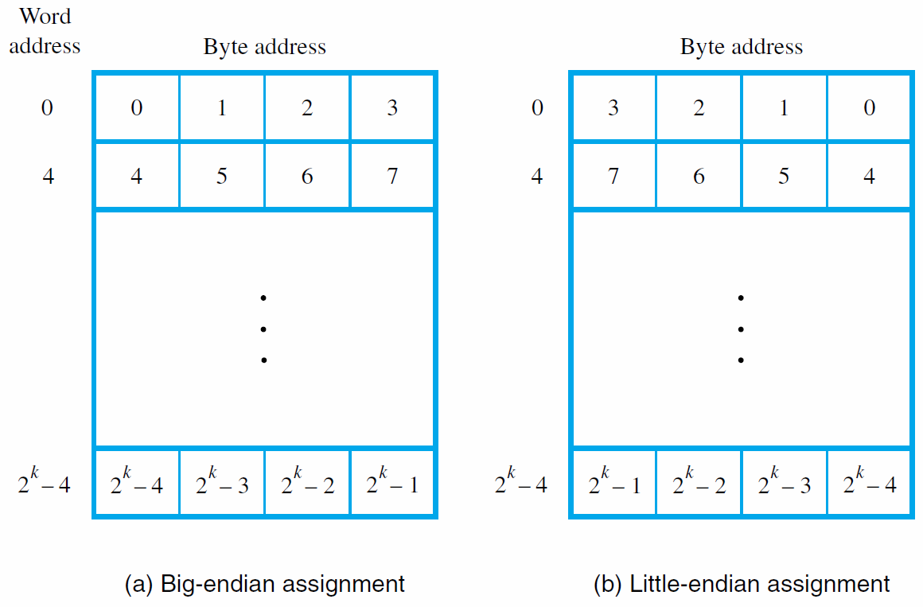

Slide 11
Word Alignment
# of bytes per word is normally a power of 2
Word locations have aligned addresses if they begin at byte addresses that are multiples of the number of bytes in a word
Examples of aligned addresses:
2 bytes per word → 0, 2, 4, …
8 bytes per word → 0, 8, 16, …
Some computers permit unaligned addresses

Slide 12
Memory Operations
Memory contains data & program instructions
Control circuits initiate transfer of data and instructions between memory and processor
Read operation: memory retrieves contents at address location given by processor
Write operation: memory overwrites contents at given location with given data

Slide 13
Instructions and Sequencing
Instructions for a computer must support:
  data transfers to and from the memory
  arithmetic and logic operations on data
  program sequencing and control
  input/output transfers
First consider data transfer & arithmetic/logic
Control and input/output examined later
Introduce notation to facilitate discussion

Slide 14
Register Transfer Notation
Register transfer notation is used to describe hardware-level data transfers and operations
Predefined names for procr. and I/O registers
Arbitrary names for locations in memory
Use […] to denote contents of a location
Use ← to denote transfer to a destination
Example: R2 ← [LOC]
(transfer from LOC in memory to register R2)

Slide 15
Register Transfer Notation
RTN can be extended to also show
arithmetic operations involving locations
Example: R4 ← [R2] + [R3]
(add the contents of registers R2 and R3,
place the sum in register R4)
Right-hand expression always denotes a value, left-hand side always names a location

Slide 16
Assembly-Language Notation
RTN shows data transfers and arithmetic
Another notation is needed to represent
machine instructions & programs using them
Assembly language is used for this purpose
For the two preceding examples using RTN,
the assembly-language instructions are:
Load R2, LOC
Add R4, R2, R3

Slide 17
Assembly-Language Notation
An instruction specifies the desired operation and the operands that are involved
Examples in this chapter will use English words for the operations (e.g., Load, Store, and Add)
This helps emphasize fundamental concepts
Commercial processors use mnemonics,
usually abbreviations (e.g., LD, ST, and ADD)
Mnemonics differ from processor to processor

Slide 18
RISC and CISC Instruction Sets
Nature of instructions distinguishes computer
Two fundamentally different approaches
Reduced Instruction Set Computers (RISC) have one-word instructions and
require arithmetic operands to be in registers
Complex Instruction Set Computers (CISC)
have multi-word instructions and
allow operands directly from memory

Slide 19
RISC Instruction Sets
Focus on RISC first because it is simpler
RISC instructions each occupy a single word
A load/store architecture is used, meaning:
  only Load and Store instructions are used
  to access memory operands
  operands for arithmetic/logic instructions
  must be in registers, or one of them
  may be given explicitly in instruction word

Slide 20
RISC Instruction Sets
Instructions/data are stored in the memory
Processor register contents are initially invalid
Because RISC requires register operands,
data transfers are required before arithmetic
The Load instruction is used for this purpose:
Load procr_register, mem_location
Addressing mode specifies memory location;
different modes are discussed later

Slide 21
RISC Instruction Sets
Consider high-level language statement:
C = A + B
A, B, and C correspond to memory locations
RTN specification with these symbolic names:
C ← [A] + [B]
Steps: fetch contents of locations A and B,
compute sum, and transfer result to location C

Slide 22
RISC Instruction Sets
Sequence of simple RISC instructions for task:
Load R2, A
Load R3, B
Add R4, R2, R3
Store R4, C
Load instruction transfers data to register
Store instruction transfers data to the memory
Destination differs with same operand order

Slide 23
A Program in the Memory
Consider the preceding 4-instruction program
How is it stored in the memory?
(32-bit word length, byte-addressable)
Place first RISC instruction word at address i
Remaining instructions are at i + 4, i + 8, i + 12
For now, assume that Load/Store instructions specify desired operand address directly;
this issue is discussed in detail later

Slide 24
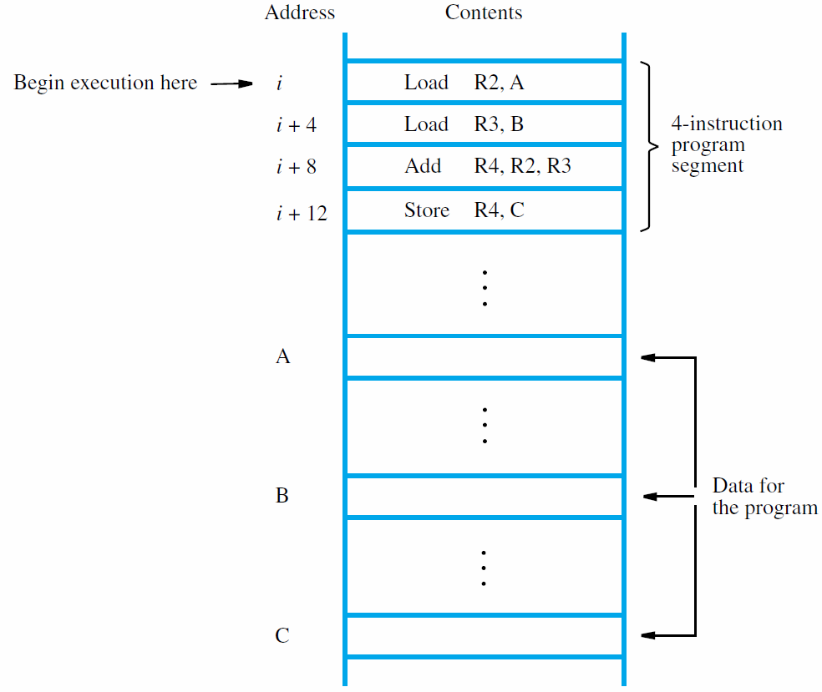

Slide 25
Instruction Execution/Sequencing
How is the program executed?
Processor has program counter (PC) register
Address i for first instruction placed in PC
Control circuits fetch and execute instructions, one after another → straight-line sequencing
During execution of each instruction,
PC register is incremented by 4
PC contents are i + 16 after Store is executed

Slide 26
Details of Instruction Execution
Two-phase procedure: fetch and execute
Fetch involves Read operation using PC value
Data placed in procr. instruction register (IR)
To complete execution, control circuits
examine encoded machine instruction in IR
Specified operation is performed in steps,
e.g., transfer operands, perform arithmetic
Also, PC is incremented, ready for next fetch

Slide 27
Branching
We can illustrate the concept of branching with a program that adds a list of numbers
Same operations performed repeatedly,
so the program contains a loop
Loop body is straight-line instruction sequence
It must determine address of next number,
load value from the memory, and add to sum
Branch instruction causes repetition of body

Slide 28
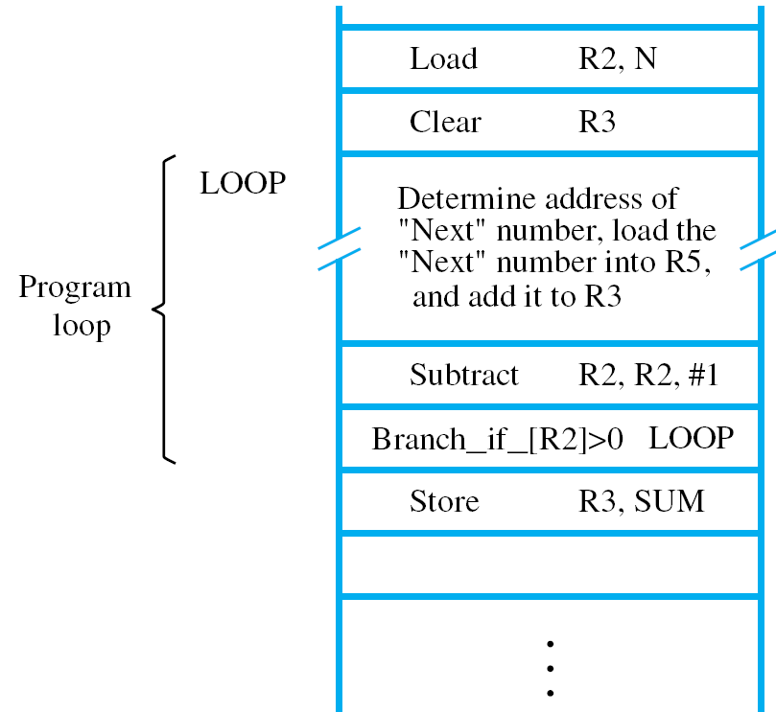

Slide 29
Branching
Assume that size of list, n, stored at location N
Use register R2 as a counter, initialized from N
Body of loop includes the instruction
Subtract R2, R2, #1
to decrement counter in each loop pass
Branch_if_[R2]>0 goes to branch target LOOP
as long as contents of R2 are greater than zero
Therefore, this is a conditional branch

Slide 30
Branching
Branches that test a condition are used in loops and various other programming tasks
One way to implement conditional branches
is to compare contents of two registers, e.g.,
Branch_if_[R4]>[R5] LOOP
In generic assembly language with mnemonics the same instruction might actually appear as
BGT R4, R5, LOOP

Slide 31
Generating Memory Addresses
Loop must obtain next number in each pass
Load instruction cannot contain full address since address size (32 bits) = instruction size
Also, Load instruction itself would have to be modified in each pass to change address
Instead, use register Ri for address location
An example of addressing modes (next topic)
Initialize to NUM1, increment by 4 inside loop

Slide 32
Addressing Modes
Programs use data structures to organize
the information used in computations
High-level languages enable programmers
to describe operations for data structures
Compiler translates into assembly language
Addressing modes provide compiler with different ways to specify operand locations
Consider modes used in RISC-style processors

Slide 33
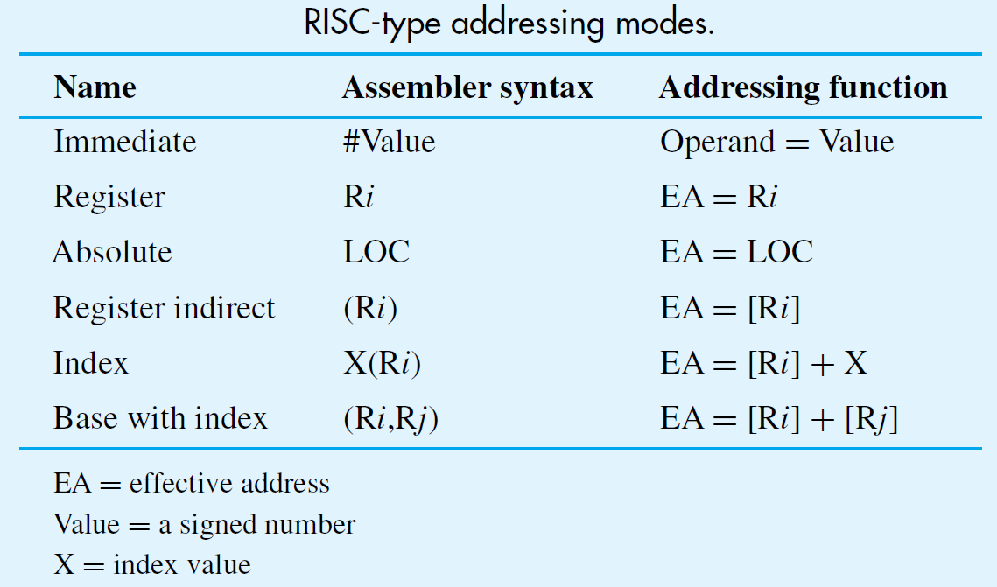

Slide 34
Addressing Modes
We have already seen examples of the
register and absolute addressing modes
RISC-style instructions have a fixed size, hence
absolute mode information limited to 16 bits
Usually sign-extended to full 32-bit address
Absolute mode is therefore limited
to a subset of the full 32-bit address space
Assume programs are limited to this subset

Slide 35
Variables
Variable declaration in high-level language:
Integer NUM1, NUM2, SUM;
Allocates storage to locations in the memory
When referenced by high-level statements,
compiler translates to assembly language:
Load R2, NUM1
Absolute mode (in subset of address space)
enables access to variables in the memory

Slide 36
Constants
Assume constant 200 is added to a variable
Immediate mode enables use of constants
in assembly-language instructions
One approach for specification:
Add R4, R6, 200_{immediate}
Not practical to use subscripts in this manner
Alternative approach uses special character:
Add R4, R6, #200

Slide 37
Indirection and Pointers
Register, absolute, and immediate modes
directly provide the operand or address
Other modes provide information from which the effective address of operand is derived
For program that adds numbers in a list,
use register as pointer to next number
Indirect mode provides address in register:
Load R2, (R5)

Slide 38
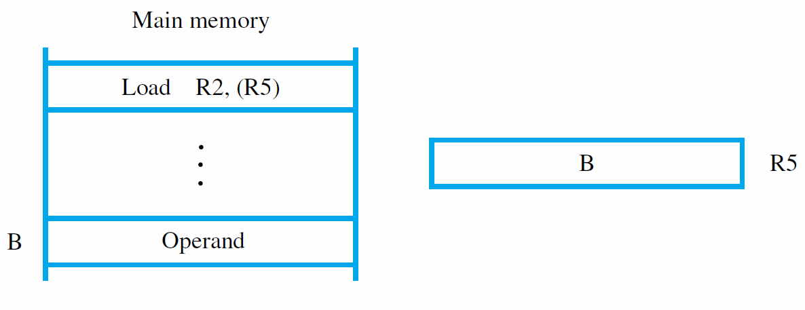

Slide 39
Indirection and Pointers
Body of loop can now use register as pointer
To initialize the pointer, use the instruction:
Move R4, #NUM1
In RISC-style processors, R0 is usually always 0
Implement using Add and immediate mode:
Add R4, R0, #NUM1
Move is a convenient pseudoinstruction
We now have complete list-addition program

Slide 40
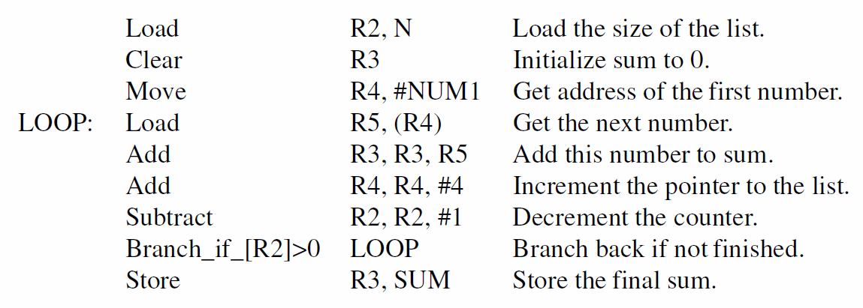

Slide 41
Indexing
Consider index mode in: Load R2, X(R5)
Effective address is given by [R5] + X
For example, assume operand address is 1020, 5 words (20 bytes) from start of array at 1000
Can put start address in R5 and use X=20
Alternatively, put offset in R5 and use X=1000
Base with index mode: Load Rk, X(Ri, Rj)
Effective address is given by [Ri] + [Rj] + X

Slide 42
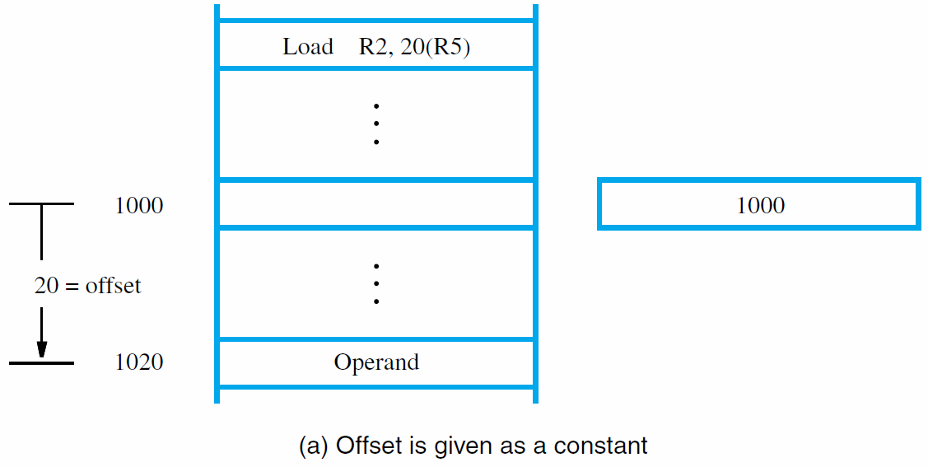

Slide 43
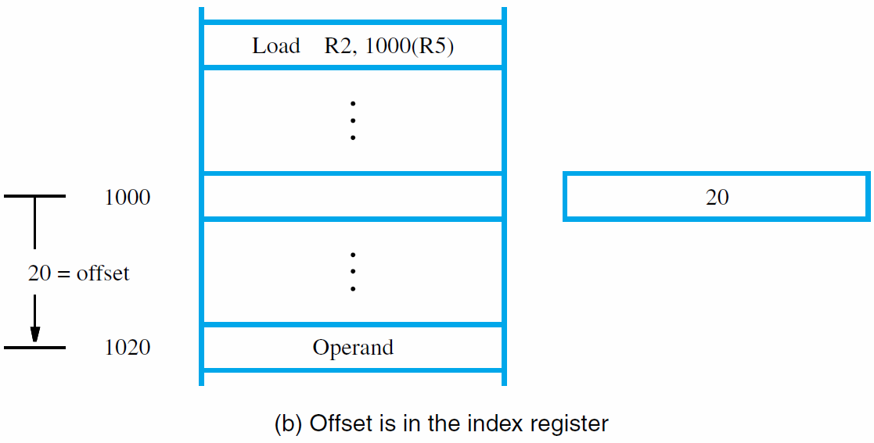

Slide 44
Assembly Language
Mnemonics (LD/ADD instead of Load/Add) used when programming specific computers
The mnemonics represent the OP codes
Assembly language is the set of mnemonics and rules for using them to write programs
The rules constitute the language syntax
Example: suffix ‘I’ to specify immediate mode
ADDI R2, R3, 5 (instead of #5)

Slide 45
Assembler Directives
Other information also needed to translate source program to object program
How should symbolic names be interpreted?
Where should instructions/data be placed?
Assembler directives provide this information
ORIGIN defines instruction/data start position
RESERVE and DATAWORD define data storage
EQU associates a name with a constant value

Slide 46
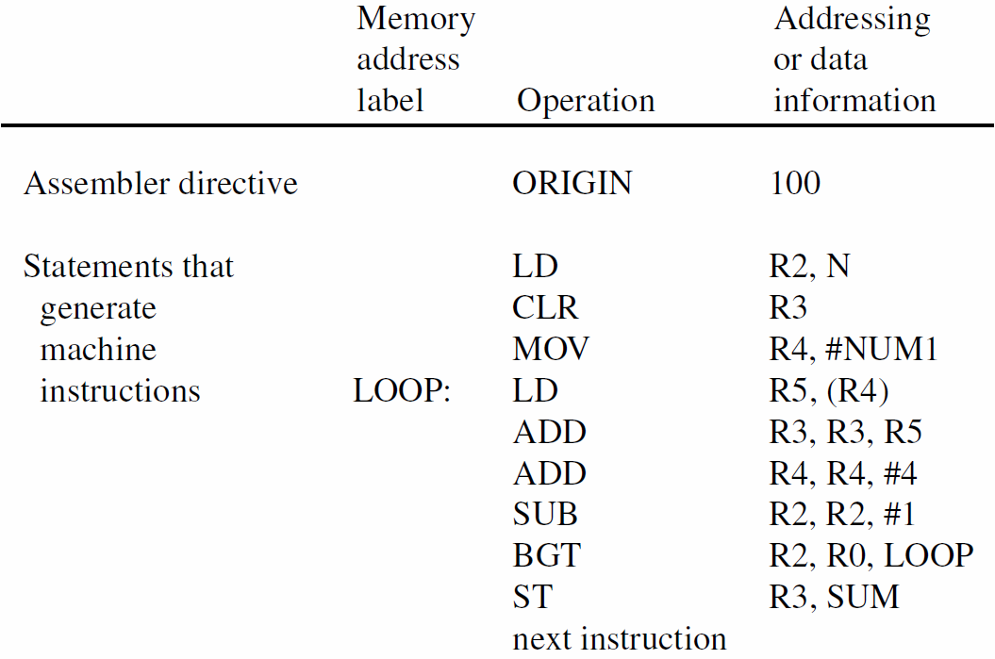
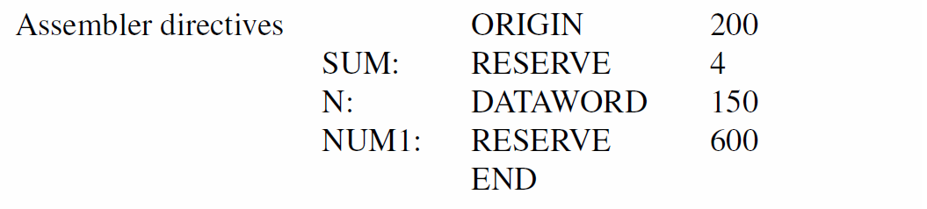

Slide 47
Program Assembly & Execution
From source program, assembler generates machine-language object program
Assembler uses ORIGIN and other directives
to determine address locations for code/data
For branches, assembler computes ±offset
from present address (in PC) to branch target
Loader places object program in memory
Debugger can be used to trace execution

Slide 48
Number Notation
Decimal numbers used as immediate values:
ADDI R2, R3, 93
Assembler translates to binary representation
Programmer may also specify binary numbers:
ADDI R2, R3, %01011101
Hexadecimal specification is also possible:
ADDI R2, R3, 0x5D
Note that 93 = 1011101₂ = 5D₁₆

Slide 49
Stacks
A stack is a list of data elements where
elements are added/removed at top end only
Also known as pushdown stack or
last-in-first-out (LIFO) stack
We push a new element on the stack top
or pop the top element from the stack
Programmer can create a stack in the memory
There is often a special processor stack as well

Slide 50
Processor Stack
Processor has stack pointer (SP) register
that points to top of the processor stack
Push operation involves two instructions:
Subtract SP, SP, #4
Store Rj, (SP)
Pop operation also involves two instructions:
Load Rj, (SP)
Add SP, SP, #4

Slide 51
Subroutines
In a given program, a particular task may be
executed many times using different data
Examples: mathematical function, list sorting
Implement task in one block of instructions
This is called a subroutine
Rather than reproduce entire subroutine block in each part of program, use a subroutine call
A Call instruction is a special type of branch

Slide 52
Subroutines
Branching to same block of instructions
saves space in memory, but must branch back
The subroutine must return to calling program
after executing last instruction in subroutine
This branch is done with a Return instruction
Subroutine can be called from different places
How can return be done to the correct place?
This is the issue of subroutine linkage

Slide 53
Subroutine Linkage
During execution of Call instruction,
PC upated to point to instruction after Call
Save this address for Return instruction to use
Simplest method: place address in link register
Call instruction performs two operations:
store updated PC contents in link register,
then branch to target (subroutine) address
Return just branches to address in link register

Slide 54
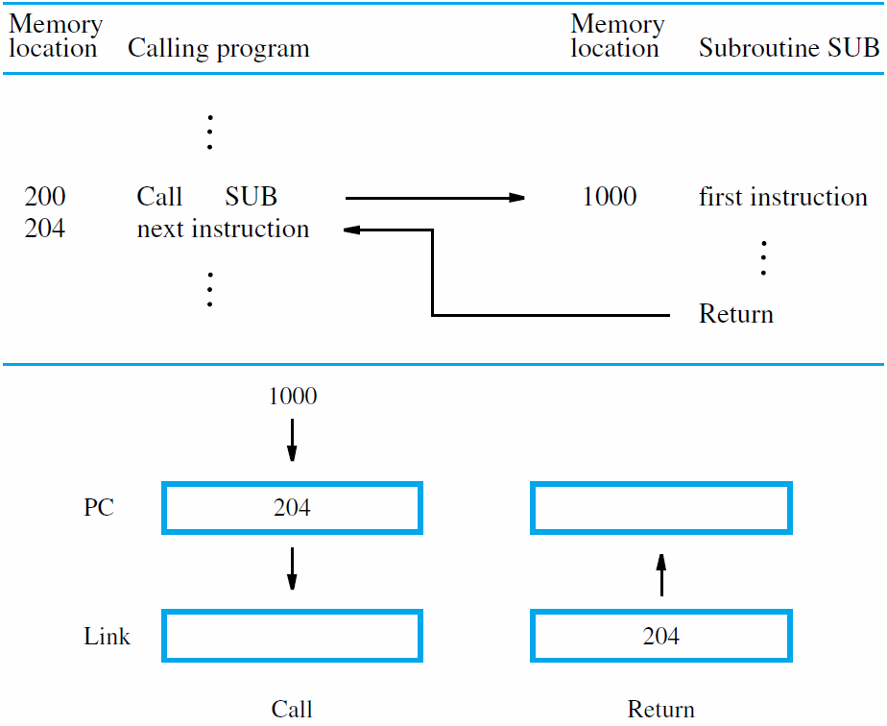

Slide 55
Subroutine Nesting and the Stack
We can permit one subroutine to call another,
which results in subroutine nesting
Link register contents after first subroutine call are overwritten after second subroutine call
First subroutine should save link register
on the processor stack before second call
After return from second subroutine,
first subroutine restores link register

Slide 56
Parameter Passing
A program may call a subroutine many times with different data to obtain different results
Information exchange to/from a subroutine
is called parameter passing
Parameters may be passed in registers
Simple, but limited to available registers
Alternative: use stack for parameter passing,
and also for local variables & saving registers

Slide 57
The Stack Frame
Locations at the top of the processor stack are used as a private work space by subroutines
A stack frame is allocated on subroutine entry and deallocated on subroutine exit
A frame pointer (FP) register enables access to private work space for current subroutine
With subroutine nesting, the stack frame also saves return address and FP of each caller

Slide 58
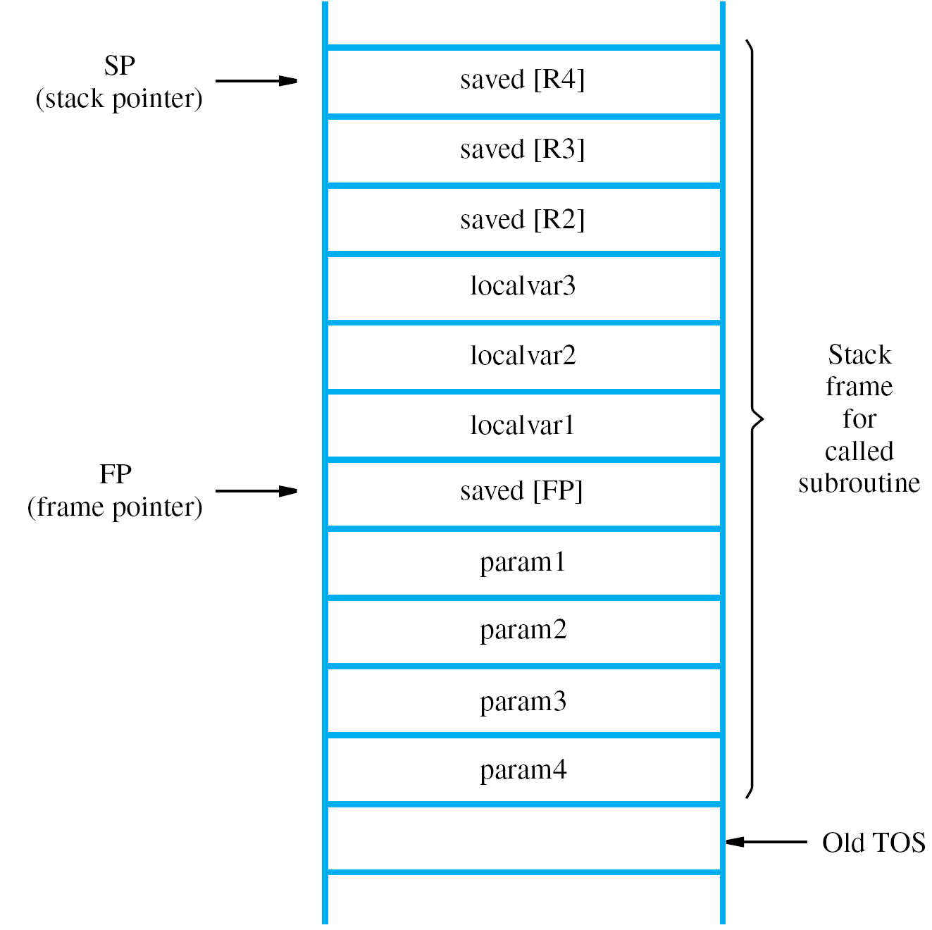

Slide 59
Logic Instructions
AND, OR, and NOT operations on single bits
are basic building blocks of digital circuits
Similar operations in software on multiple bits
Using RISC-style instructions, all operands are
in registers or specified as immediate values:
Or R4, R2, R3
And R5, R6, #0xFF
16-bit immediate is zero-extended to 32 bits

Slide 60
Shift and Rotate Instructions
Shifting binary value left/right = mult/div by 2
Arithmetic shift preserves sign in most sig. bit
Rotate copies bits from one end to other end
Shift amount in register or given as immediate
Carry flag (discussed later) may be involved
Examples:
LShiftL R3, R3, #2 (mult by 4)
RotateL R3, R3, #2 (MS bits to LS bits)

Slide 61
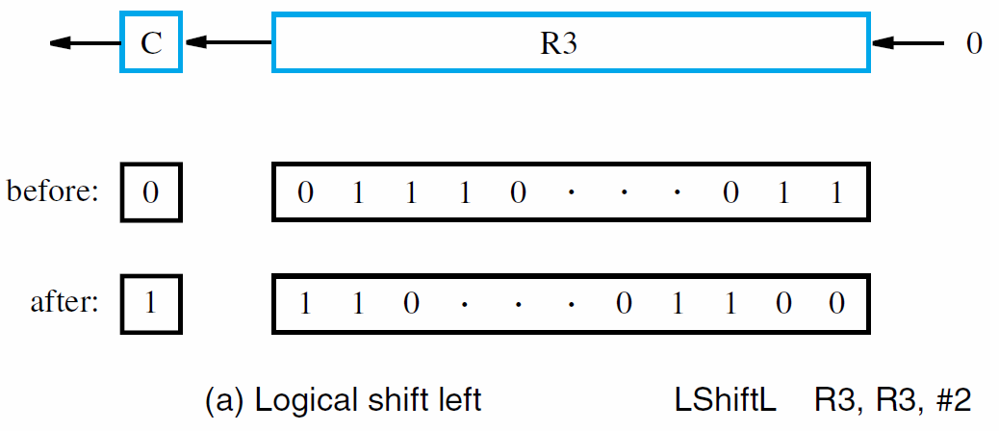

Slide 62
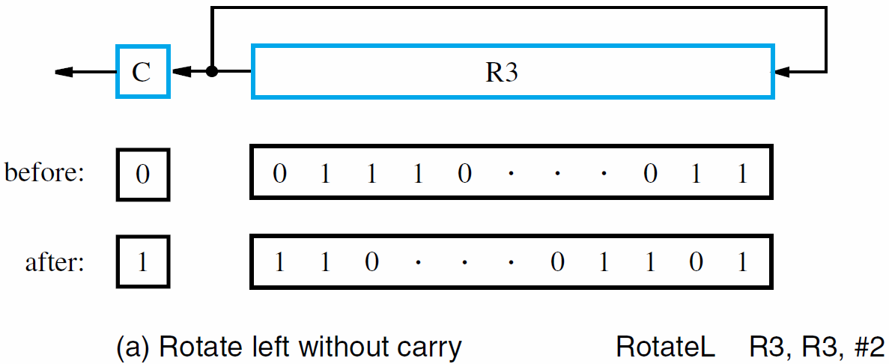

Slide 63
Example Program: Digit Packing
Illustrate shift, logic, byte-access instructions
Memory has two binary-coded decimal digits
Pointer set to 1st byte for index-mode access to load 1st digit, which is shifted to upper bits
Upper bits of 2nd digit are cleared by ANDing
ORing combines 2nd digit with shifted 1st digit for result of two packed digits in a single byte
32-bit registers, but only 8 lowest bits relevant

Slide 64
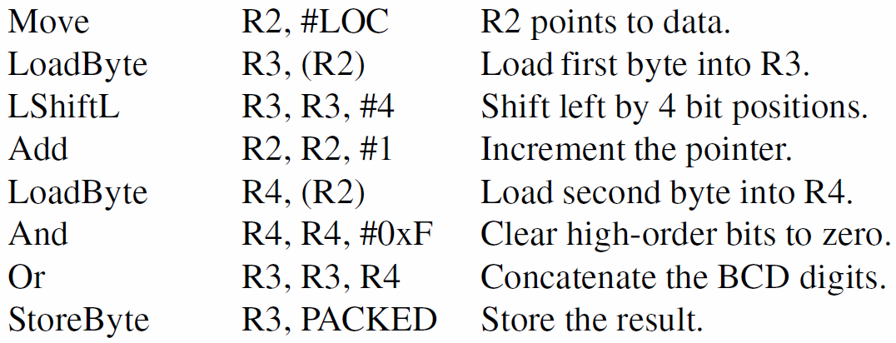

Slide 65
Multiplication and Division
Signed integer multiplication of n-bit numbers produces a product with up to 2n bits
Processor truncates product to fit in a register:
Multiply Rk, Ri, Rj (Rk ← [Ri] × [Rj])
For general case, 2 registers may hold result
Integer division produces quotient as result:
Divide Rk, Ri, Rj (Rk ← [Ri] / [Rj])
Remainder is discarded or placed in a register

Slide 66
32-bit Immediate Values
To construct 32-bit immediates or addresses, use two instructions in sequence:
OrHigh R2, R0, #0x2000
Or R2, R2, #0x4FF0
Result is 0x20004FF0 in register R2
Useful pseudoinstruction for above sequence:
MoveImmediateAddress R2, LOC
Assembler can substitute OrHigh & Or and
generate appropriate 16-bit values for each

Slide 67
CISC Instruction Sets
Not constrained to load/store architecture
Instructions may be larger than one word
Typically use two-operand instruction format, with at least one operand in a register
Implementation of C = A + B using CISC:
Move Ri, A
Add Ri, B
Move C, Ri

Slide 68
CISC Instruction Sets
Move instruction equivalent to Load/Store
But also can transfer immediate values
and possibly between two memory locations
Arithmetic instructions may employ
addressing modes for operands in memory:
Subtract LOC, Ri
Add Rj, 16(Rk)

Slide 69
Additional Addressing Modes
CISC style has other modes not usual for RISC
Autoincrement mode: effective address given by register contents; after accessing operand, register contents incremented to point to next
Useful for adjusting pointers in loop body:
Add SUM, (Ri)+
MoveByte (Rj)+, Rk
Increment by 4 for words, and by 1 for bytes

Slide 70
Additional Addressing Modes
Autodecrement mode: before accessing operand, register contents are decremented, then new contents provide effective address
Notation in assembly language:
Add Rj, −(Ri)
Use autoinc. & autodec. for stack operations:
Move −(SP), NEWITEM (push)
Move ITEM, (SP)+ (pop)

Slide 71
Condition Codes
Processor can maintain information on results to affect subsequent conditional branches
Results from arithmetic/comparison & Move
Condition code flags in a status register:
N (negative) 1 if result negative, else 0
Z (zero) 1 if result zero, else 0
V (overflow) 1 if overflow occurs, else 0
C (carry) 1 if carry-out occurs, else 0

Slide 72
Branches using Condition Codes
CISC branches check condition code flags
For example, decrementing a register causes N and Z flags to be cleared if result is > zero
A branch to check logic condition N + Z = 0:
Branch>0 LOOP
Other branches test conditions for <, =, ≠, ≤, ≥
Also Branch_if_overflow and Branch_if_carry
Consider CISC-style list-summing program

Slide 73
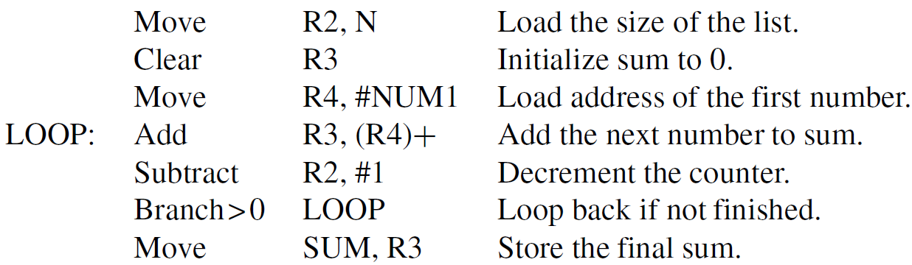

Slide 74
RISC and CISC Styles
RISC characteristics include:
simple addressing modes
all instructions fitting in a single word
fewer total instructions
arithmetic/logic operations on registers
load/store architecture for data transfers
more instructions executed per program
Simpler instructions make it easier to
design faster hardware (e.g., use of pipelining)

Slide 75
RISC and CISC Styles
CISC characteristics include:
more complex addressing modes
instructions spanning more than one word
more instructions for complex tasks
arithmetic/logic operations on memory
memory-to-memory data transfers
fewer instructions executed per program
Complexity makes it somewhat more difficult to design fast hardware, but still possible

Slide 76
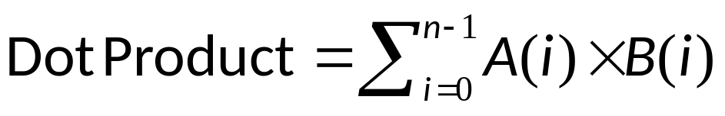
Example Programs
First example program computes:
First elements of each array, A(0) and B(0), are stored at memory locations AVEC and BVEC
Consider RISC and CISC versions of program
Use Multiply instruction on pairs of elements and accumulate sum with Add instruction
Some processors have MultiplyAccumulate

Slide 77
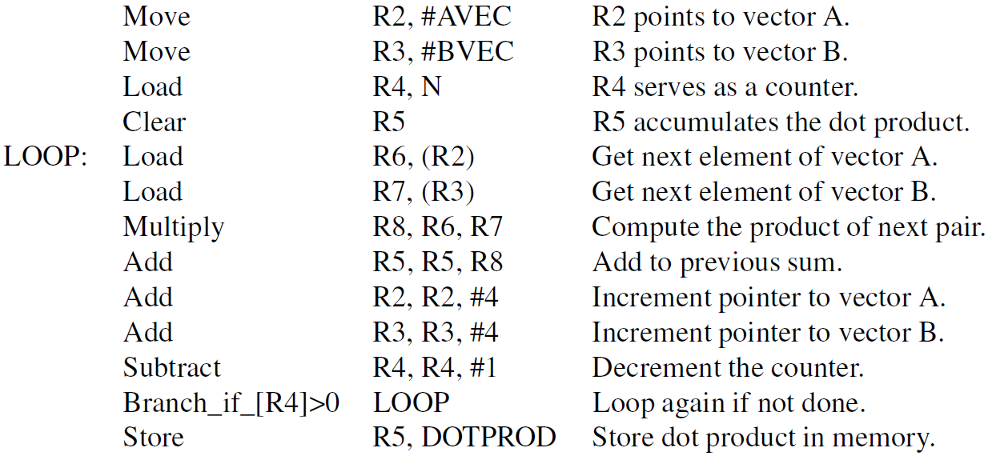

Slide 78
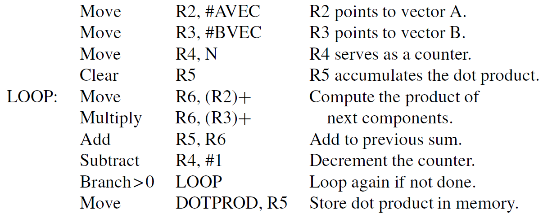

Slide 79
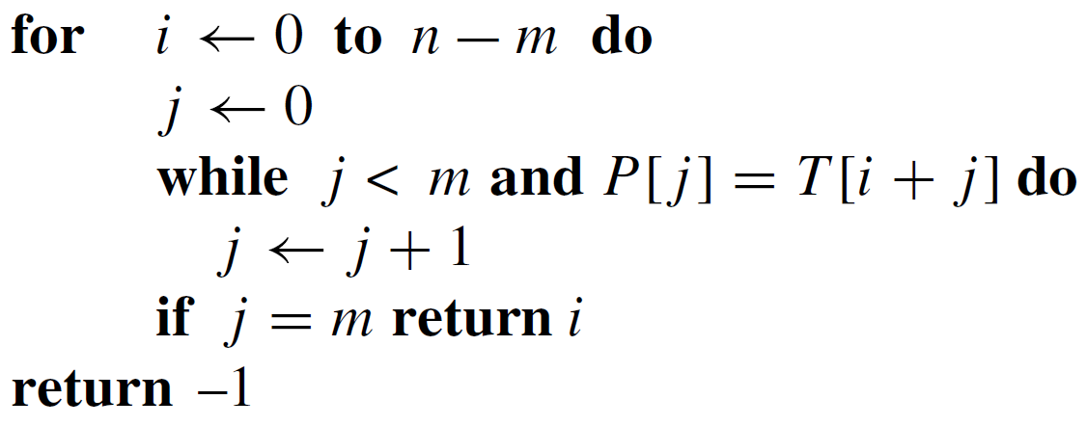
Example Programs
Second example searches for 1st occurrence
of pattern string P in target string T
String P has length m and string T has length n
Algorithm to implement in RISC/CISC styles:

Slide 80
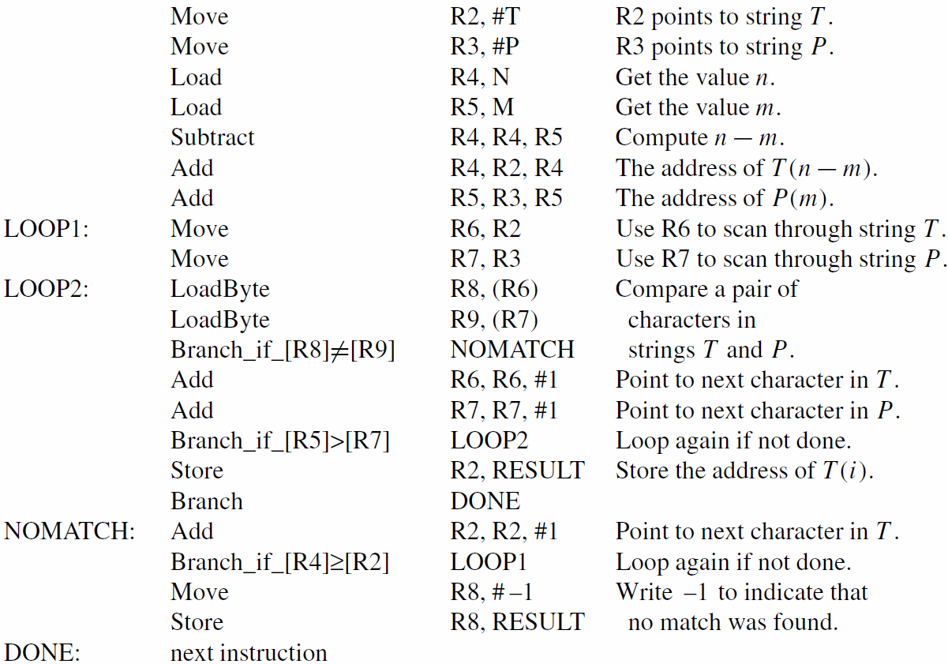

Slide 81
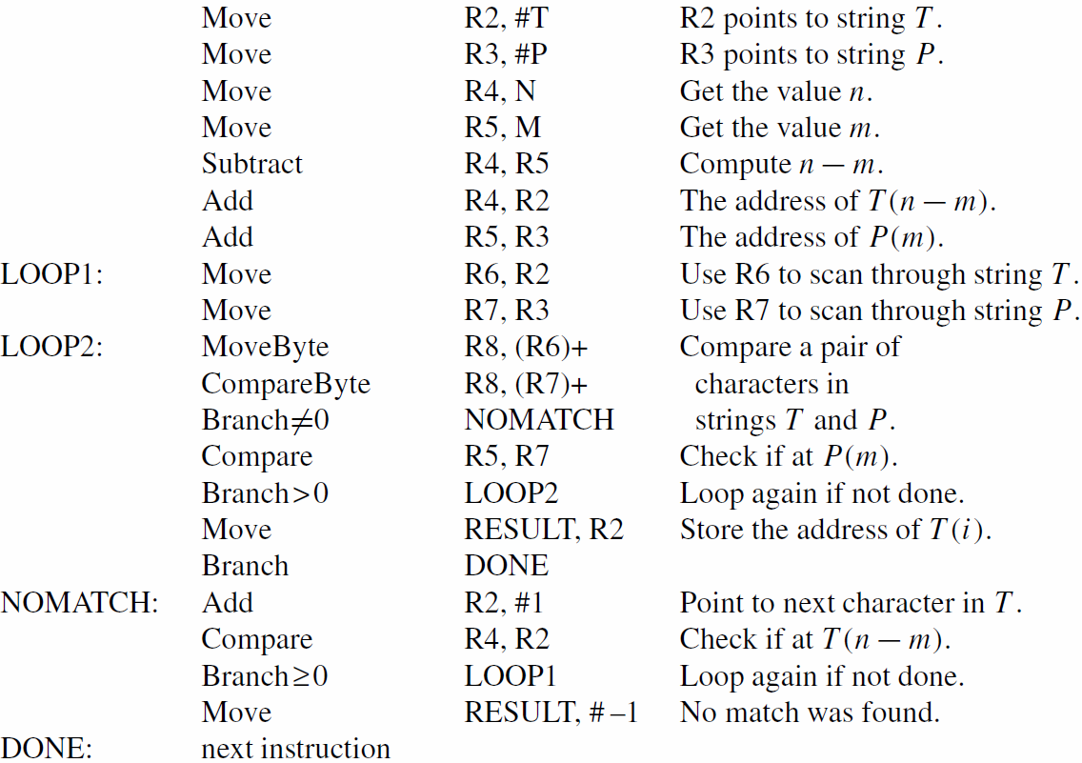

Slide 82
Encoding of Machine Instructions
Assembly-language instructions express the actions to be performed by processor circuitry
Assembler converts to machine instructions
Three-operand RISC instructions require
enough bits in single word to identify registers
16-bit immediates must be supported
Instruction must include bits for OP code
Call instruction also needs bits for address

Slide 83
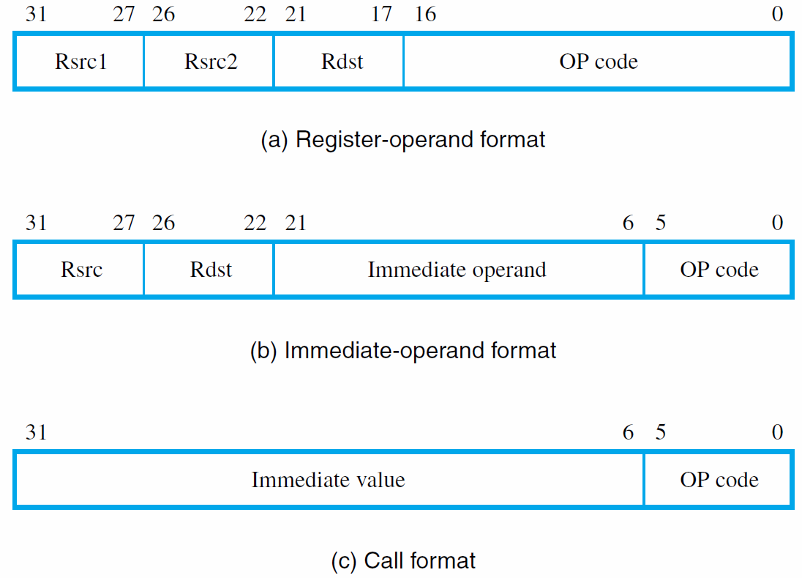

Slide 84
Concluding Remarks
Many fundamental concepts presented:
  memory locations, byte addressability, endianness
  assembly-language and register-transfer notation
  RISC-style and CISC-style instruction sets
  addressing modes and instruction execution
  assembler to generate machine instructions
  subroutines and the processor stack
Later chapters build on these concepts

